Slide 1
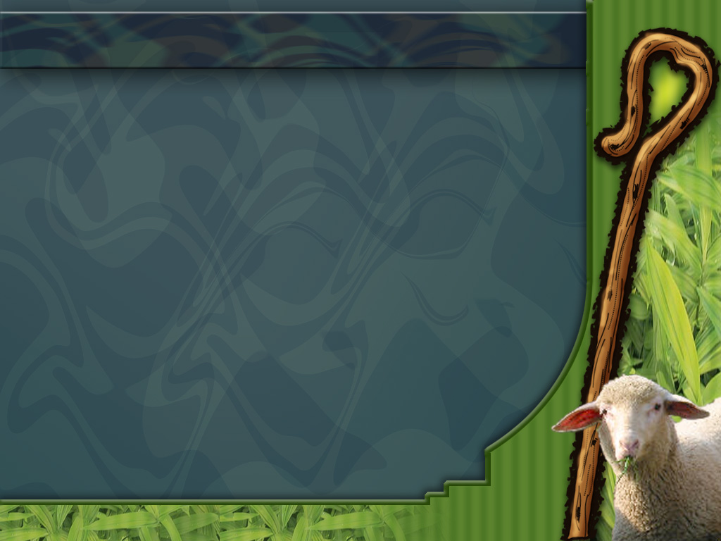

Music and Acoustic Engineering
Advanced Coding Tools and Methodologies
Prof. Bruschi Francesco
Prof. Rana Vincenzo
SHEEP-PHONY
A project by
Curcio Lorenzo
Bernasconi Marco
Albarracín Sánchez Juan Camilo

Slide 2
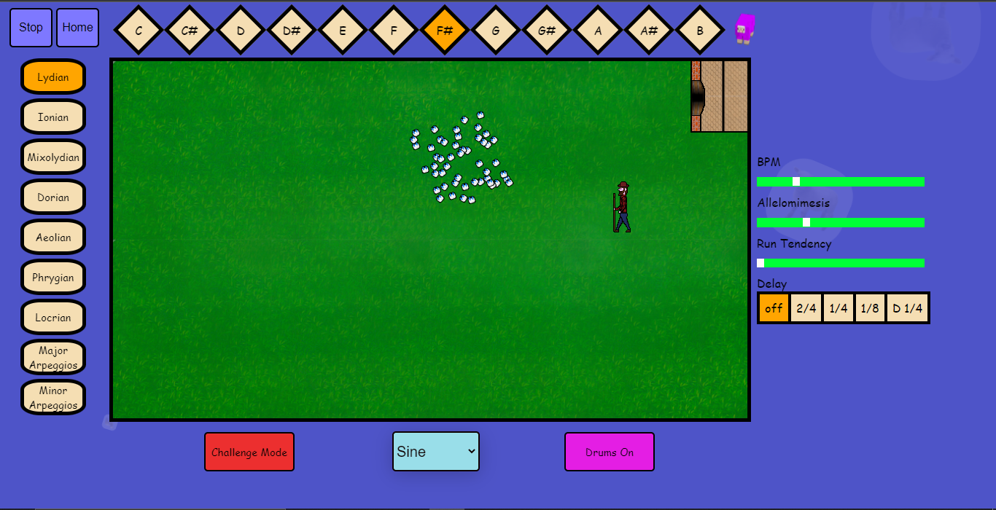
SHEEPS INTERFACE
Model from:
Intermittent collective dynamics emerge from conflicting imperatives in sheep herds. By Francesco Ginelli et al.
Slide 0/11

Slide 3



SHEEPS MOVEMENT
Sheeps are represented by point-like agents able to perceive and respond to their local environment.
The state of each sheep is represented by its speed at a certain time.
Stationary sheeps don’t change their position, while
walking and running ones do.
$$q_{i}^{t} ∈\{0,1,2\}$$
Stationary or walking sheep
Running sheep
Slide 1/11

Slide 4
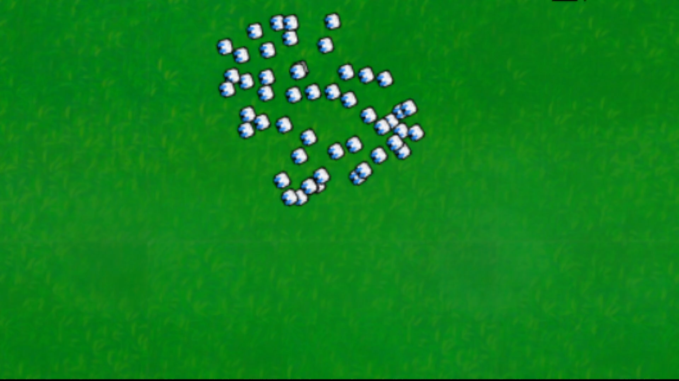



SHEEPS MOVEMENT
The evolution of the position of each sheep is described by the following equations.
Heading vector
$$r_{i}^{t+∆t}=r_{i}^{t}+v∆t s_{i}^{t+∆t}$$
Random noise
$$θ_{i}^{t+∆t}=Arg\sum_{j ε M}{s_{j}^{t}}+φ_{i}^{t}$$
Unit vector from sheep i to sheep j
$$θ_{i}^{t+∆t}=Arg\sum_{j ε M}{[δ_{2,q_{j}^{t}} s_{j}^{t}}+ β\min\left(1, \frac{r_{ij}^{t}−r_{e}}{r_{e}}\right)e_{ij}^{t}]$$
Metric neighbours
Cohesion
Equilibrium distance
Slide 2/11

Slide 5





SHEEPS MOVEMENT
A sheep decides whether to change its state according to the following probabilities.
$p_{0→1}\left(i,t\right)=\frac{1+α n_{1}^{t}\left(i\right)}{τ_{0→1}}$
$p_{1→0}\left(i,t\right)=\frac{1+α n_{0}^{t}\left(i\right)}{τ_{1→0}}$
$p_{0,1→2}\left(i,t\right)=\frac{1}{τ_{0,1→2}}$ ${\text{[}\frac{l_{i}^{t}}{d_{R}}(1+α n_{2}^{t}\left(i\right))]}^{δ}$
$$p_{2→0}\left(i,t\right)=\frac{1}{τ_{2→0}}{\text{[}\frac{d_{S}}{l_{i}^{t}}(1+α n_{0}^{t}\left(i\right))]}^{δ}$$
$τ_{i→j}=spontaneous transition time from state i to state j$
$α$ and $δ$ = allelomimetic parameters
$n_{i}^{t}$ = number of metric neighbours that are in state i at time t
$l_{i}^{t}$ = average distance from sheep i to other sheeps at time t
$d_{S}$ and $d_{R}$ = characteristic lengths
Slide 3/11

Slide 6



SHEEPS PARAMETERS
$p_{1→0}\left(i,t\right)=\frac{1+α n_{0}^{t}\left(i\right)}{τ_{1→0}}$
Allelomimesis
$p_{0,1→2}\left(i,t\right)=\frac{1}{τ_{0,1→2}}$ ${\text{[}\frac{l_{i}^{t}}{d_{R}}(1+α n_{2}^{t}\left(i\right))]}^{δ}$
Run Tendency
Sheeps behaviour is set the same way as it was in the reference paper, although the user can still customize some of the parameters to see how it affects the music.
Slide 4/11

Slide 7

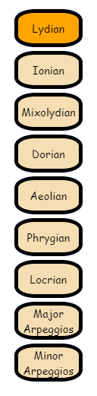
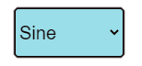
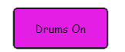
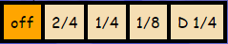
SHEEPS MUSIC
The way the sheeps change their state is used to create music.
function play(n)
function playDrums()
Delay
Slide 5/11

Slide 8

SHEEPS MELODY
The following code is executed once every n frames, depending on how fast the BPM is set. The four notes are equally spaced inside each measure.
BPM
//Notes
setTimeout(function(){play(ms)},0)
setTimeout(function(){play(mr)},(2.5)/(10*fps)*1000*framesPermeasure)
setTimeout(function(){play(mw)},(5)/(10*fps)*1000*framesPermeasure)
setTimeout(function(){play(ms+mw+mr)},(7.5)/(10*fps)*1000*framesPermeasure)
$mr, mw, ms=$number of sheeps that respectively started running, walking or stopped
Slide 6/11

Slide 9
SHEEPS DRUMS
Drums are played using a similar logic, some conditions
are related to the number of sheeps that stopped in the
particular frame
if (mr>=10)
crash.play()
else if (mr>=5)
ride.play()
else if (n_pecore_stay<5)
kick.play()
if (n_pecore_stay<25){
if (ms<3)
setTimeout(function(){rewind(closed_hat)},(2.5)/(10*fps)*1000*framesPermeasure)
else if (ms<15)
setTimeout(function(){rewind(closed_hat)},(5)/(10*fps)*1000*framesPermeasure)
if (ms==0)
setTimeout(function(){rewind(closed_hat)},(7.5)/(10*fps)*1000*framesPermeasure)
}
if (ms<25){
if (ms>=15)
setTimeout(function(){rewind(snare)},(2.5)/(10*fps)*1000*framesPermeasure)
else if (ms>=10)
setTimeout(function(){rewind(snare)},(5)/(10*fps)*1000*framesPermeasure)
if (ms>=2)
setTimeout(function(){rewind(snare)},(7.5)/(10*fps)*1000*framesPermeasure)
}
if (ms<25){
if (mw>=20)
setTimeout(function(){rewind(open_hat)},(2.5)/(10*fps)*1000*framesPermeasure)
else if (mw>=10)
setTimeout(function(){rewind(open_hat)},(5)/(10*fps)*1000*framesPermeasure)
if (mw>=5)
setTimeout(function(){rewind(open_hat)},(7.5)/(10*fps)*1000*framesPermeasure)
}
if (n_pecore_stay>=30){
if (mw<3)
setTimeout(function(){rewind(tom)},(2.5)/(10*fps)*1000*framesPermeasure)
else if (mw<5)
setTimeout(function(){rewind(tom)},(5)/(10*fps)*1000*framesPermeasure)
if (mw==0)
setTimeout(function(){rewind(tom)},(7.5)/(10*fps)*1000*framesPermeasure)
}
Slide 7/11

Slide 10


SHEEPS PANNING
Thanks to the panner node, sound is perceived as if the user were in the position of the sheperd (listener), in respect to the centroid of the herd (source). Drums are heard moving all around the listener.
Slide 8/11

Slide 11


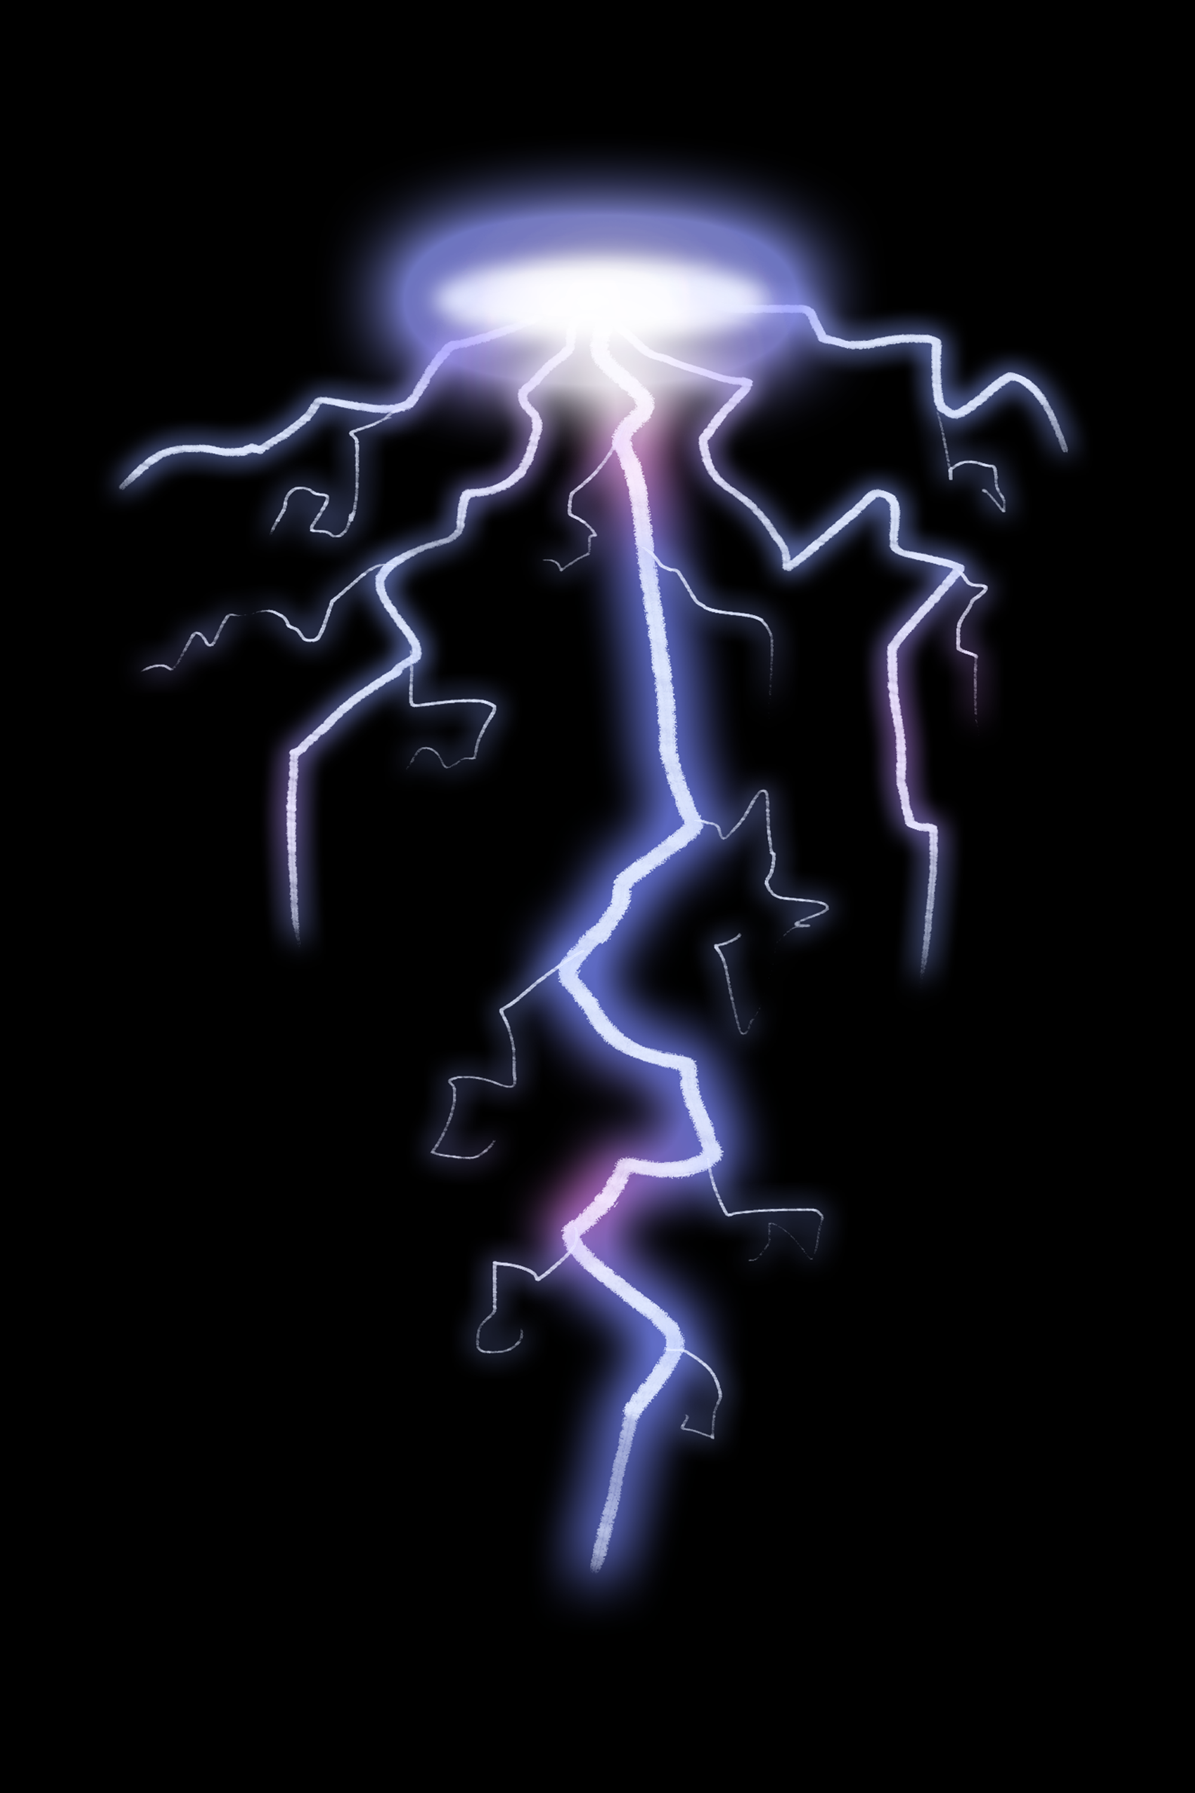
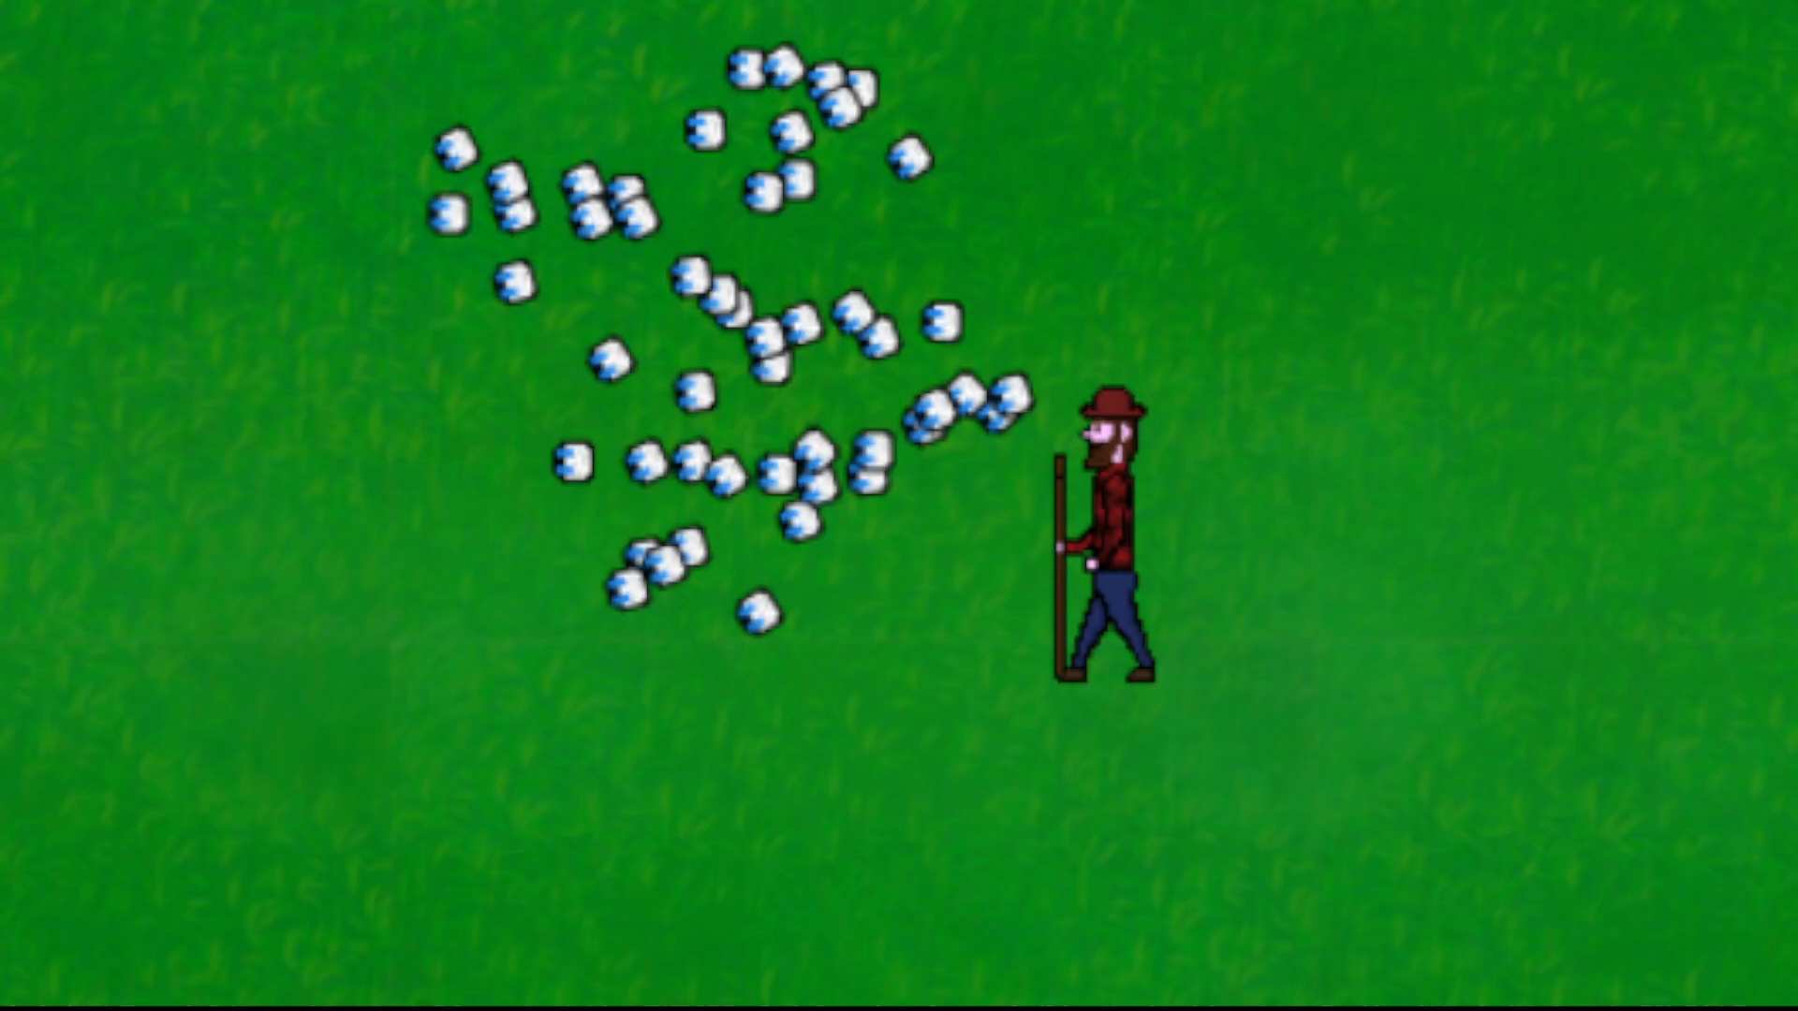
SHEEPS FEELINGS
The user can even choose to scare out the entire herd by making noise whose critical threshold is a function of the distance between the sheperd and the centroid.
!
Trying to leave the field results in the fence firing an electric shock and in the music being slightly detuned.
Slide 9/11

Slide 12
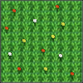

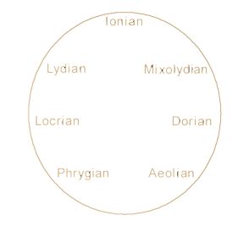
SHEEPS CHALLENGE
In challenge mode, the user must scare the sheeps towards the healthy grass zones. Once enough grass is eaten, the sheeps can go back in their little house before the wolf comes.
Each time they eat, the mode in which they sing is switched to a happier one, following the circle of fifths.
Slide 10/11

Slide 13
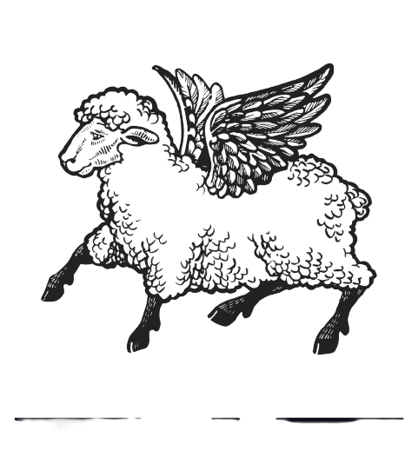
SHEEPS THANKS
Thanks for the attention
Slide 11/11

